Slide 1



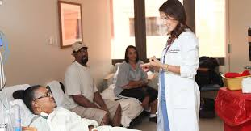

Thursday, June 25, 2020 12:00 p.m. – 12:30 p.m.
Improving Patient Experience in Virginia Hospitals and Health Systems

Slide 2
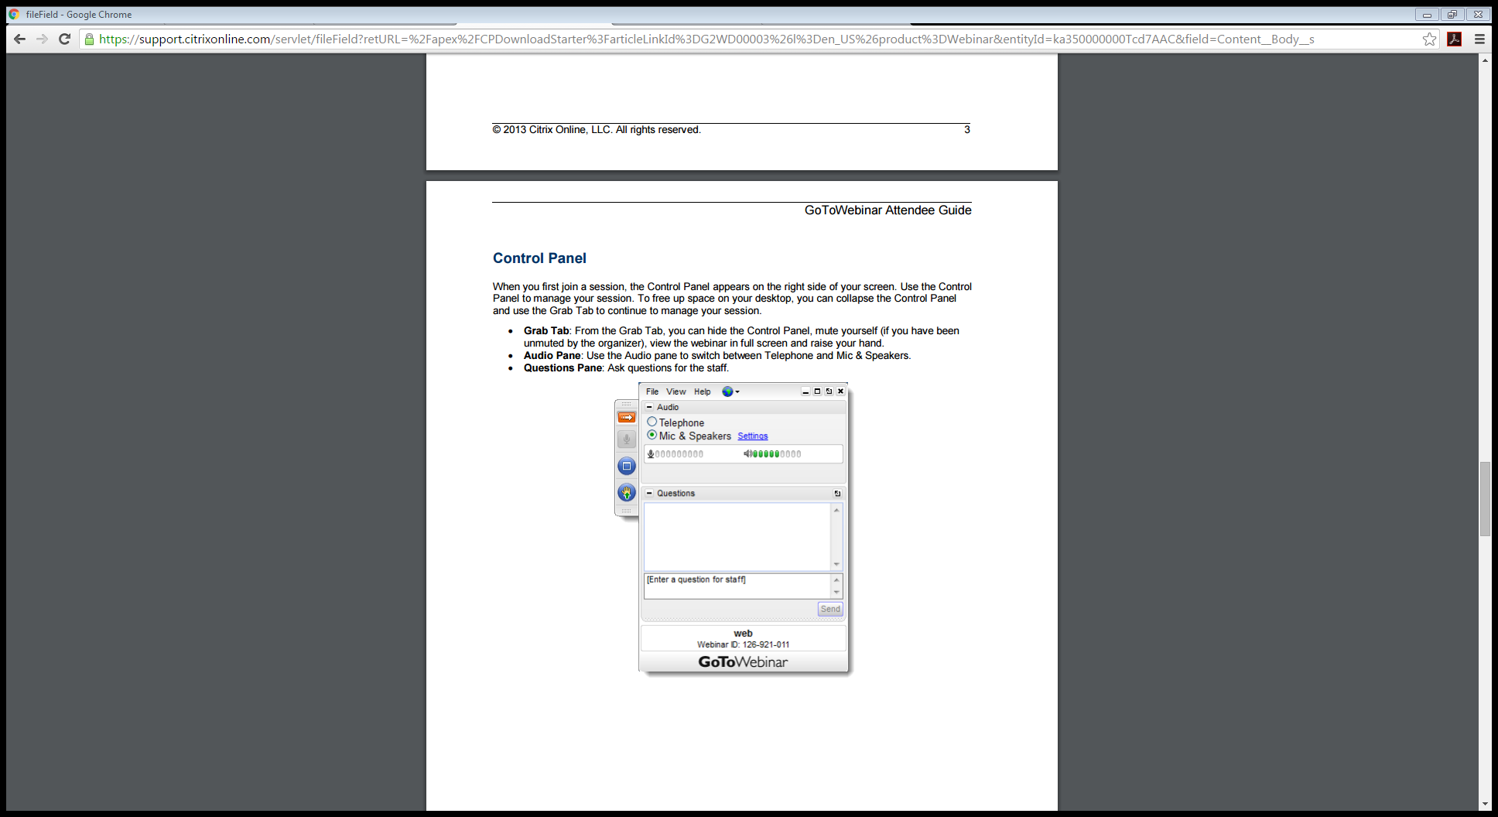
Housekeeping
Webinar is being recorded
All participants are in listen-only mode
Ask questions or make comments by typing in the Questions box
Slides are available for download in the Handouts section of the webinar control panel
Slides and recordings will be available on the VHHA Quality & Safety website
Feedback survey will launch at conclusion of the webinar

Slide 3
Today’s Agenda
VHHA Year of Patient Experience Overview and Webinar Objectives
-Abraham Segres, VHHA
Patient Experience: Before During and After COVID-19
-Nancy Wick Littlefield, DNP, RN, FACHE, NEA-BC,
EVP/CNO Riverside Health System
Polling, Discussion and Questions
-Carrie Brady, VHHA Partner
Adjourn

Slide 4

Vision
Through the power of collaboration, the association will be the recognized driving force behind making Virginia the healthiest state in the nation.
Mission
Working with our members and other stakeholders, the Association will transform Virginia's health care system to achieve top-tier performance in safety, quality, value, service, and population health. The Association's leadership is focused on: improving access to care; continuing to improve health care safety, quality, and service; promoting a vibrant, high-value health care system; and, advancing population health to promote health and economic opportunity for all Virginians.

Slide 5
VHHA Member Hospitals and Health Systems
Augusta Health
Ballad Health
Bath Community Hospital
Bon Secours Mercy Health
Buchanan General Hospital
Carilion Clinic
Centra Health
Chesapeake Regional Healthcare
Children’s Hospital of The King’s Daughters
Children’s National Medical Center
Encompass Health
HCA Virginia Health System
Inova Health System
Lake Taylor Transitional Care Hospital
LifePoint Health
Mary Washington Healthcare
Novant Health UVA Health System
Riverside Health System
Sentara Healthcare
Sheltering Arms
Universal Health Services
University of Virginia Health System
Valley Health
VCU Health System
Vibra Hospital
Virginia Hospital Center

Slide 6

Goals:
Identify: Identify, highlight and celebrate efforts by Virginia hospitals and health systems to improve the patient experience of care.
Integrate: Continue to link and integrate patient experience improvement efforts with broader quality and patient safety improvement efforts.
Connect: Facilitate connections between Virginia hospitals and health systems and other stakeholders for the purpose of shared learning.
Improve: Support efforts to improve Virginia hospitals’ individual and aggregate performance on national patient experience measures.

Slide 7
Today’s Objectives:
Share key insights and observations, including:
The impact of COVID-19 on HCAHPS performance
Staff attitudes toward patient engagement with friends and family
Essential patient experience practices that make a difference

Slide 8
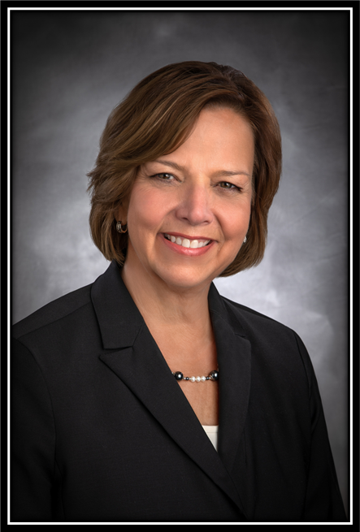
Nancy W. Littlefield DNP, RN, FACHE, NEA-BC
EVP/Chief Nursing Officer
Riverside Health System
Chair, VHHA Patient & Family Experience Forum

Slide 9
Patient Experience: Before During and After COVID-19
Nancy Wick Littlefield, DNP, RN, FACHE, NEA-BC
EVP/CNO Riverside Health System

Slide 10
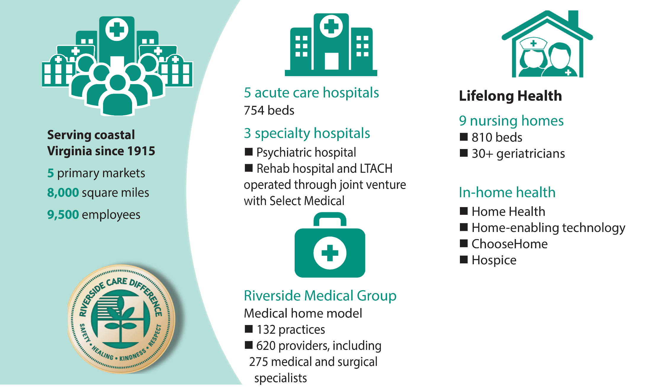

RIVERSIDE HEALTH SYSTEM
Riverside Health System

Slide 11
Riverside Health System

Slide 12
What drove our YOY improvement?
Data transparency
Leadership engagement
Purposeful communication regarding action of accountability and their outcomes
Real time feedback
Alignment of mission to results
Transition of people
Improvement in staffing to volume and a focus to remove agency
Stopped chasing the latest strategy

Slide 13
And Then Came COVID-19

Slide 14
A Review of Our Patient Comments
“Because of Covid 19 my wife was not allowed in! The doctor only called once and did not communicate anything to her.”
“Everyone was very nice to me during my stay BUT I am deaf and had some problems understanding sometimes through a mask. Not having family visits during the virus scare was uncomfortable.”
“Responding to my call bell took longer than last time I was in the hospital”
“Communication was difficult because my wife couldn’t be with me to hear what I needed.”
“Food was cold and served on paper plates”
“I kept having to remind the staff about noise not letting me rest”

Slide 15

But Why?
While most hospitals were reporting a “halo” effect from healthcare heroes, we were not
Our focus of improvement changed
“Connection” with our patients and the strategy we used for our improvement changed
Leadership rounding changed
Visitation restrictions

Slide 16
How are we doing today?

Slide 17
Lessons Learned
Past improvement was indicative we were on the right track
React quickly and adapt to the new “normal”
Leadership rounding
Hardwire communication strategy to connect to loved ones
Narrate all care provided
Adjust for PPE and lack of personal connection—eye contact and awareness of body language
Be resilient in change, eyes on the target

Slide 18
Listen
Hi, so many of us would like to chime in and give our support as well for using the current visitor limitation as an opportunity to re-institute reasonable visitation when things start to reopen. We completely understand the CMS guidelines that patients have a right to have visitors, but the CMS guidelines also make provision for setting reasonable limits to prevent "disruptive behavior" and "interfering with care of other patients." These are the concerns most of us are expressing, the fact that complete free-for-all visitation does in fact have a negative impact on the therapeutic environment. So many of us hope that we will take this as an opportunity to sort of "reset" things because the current restful environment is so much more therapeutic for the patients--including for many who say that they feel obligated to receive visitors when they show up, and who voice relief at being able to just rest and not have so much well-meaning company. Thanks for listening, and we hope there is a policy change.

Slide 19
Ongoing Focus and Work

Slide 20
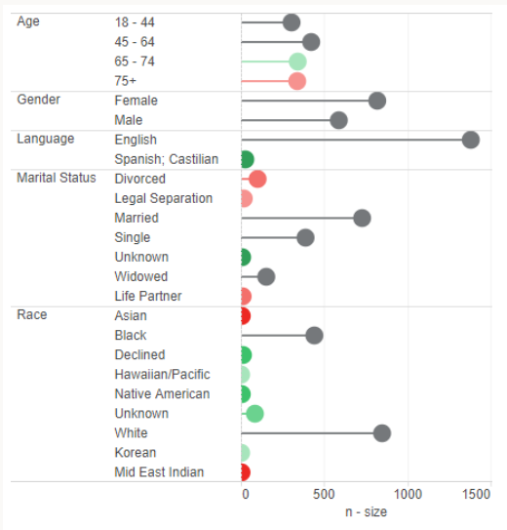
Population Segmentation Inpatient Real-Time Survey n-size by Age, Gender, Language, Marital Status and Race January 1, 2020 – June 17, 2020
Data Source: NRC Real-Time
Date Pulled: 6/17/2020

Slide 21
Ongoing Focus and Work
The importance of connection
Family and Advisory Groups
Diversity and Inclusion
High reliability

Slide 22
Happy to take any questions….

Slide 23

Polling Questions and Discussion
Carrie Brady
VHHA Patient Experience and HCAHPS Advisor

Slide 24

2020 Year of Patient Experience
Leadership
Patient and Family Engagement
Staff Engagement
Effective Use of Data
Grounded in Four Essential Foundations for Success

Slide 25
Polling Question #1: Staff Attitude Toward Visitation
How did pandemic restrictions on visitation impact staff attitudes toward future visitor policies?
Staff is more favorable toward an open visitation policy (e.g. because they see the benefits of having family/friends present to support the patient)
Staff would prefer more restricted visitation permanently
No change in staff attitudes
Unknown

Slide 26
Polling Question #2: Leader Rounding on Patients
How has the pandemic affected the frequency of leader rounding on patients?
Leaders round more frequently than before the pandemic
No change in leader rounding frequency
Leaders round less frequently than before the pandemic

Slide 27
Polling Question #3: Leader Rounding on Staff
How has the pandemic affected the frequency of leader rounding on staff?
Leaders round more frequently than before the pandemic
No change in leader rounding frequency
Leaders round less frequently than before the pandemic

Slide 28
Finding New Ways of Listening
Changing environment facilitates a fresh look – no one is an expert
e.g. enhancing communication
Capitalize on new opportunities for collaboration with frontline staff
Connect with the community for guidance

Slide 29

Upcoming Webinars
Date/Time: Featured Presenter:
July 23 Mary Mannix and Crystal Farmer
12:00 noon CEO and CNO, Augusta Health
Fishersville, Virginia
August 27 Nathan Cunningham
12:00 noon Manager- Patient Experience & Department of Patient Centered Services, VCU Health Richmond, Virginia
September 24 Insights from VHHA/Studer Group Collaborative
12:00 noon Five (5) Virginia Hospitals & Studer Coach

Slide 30

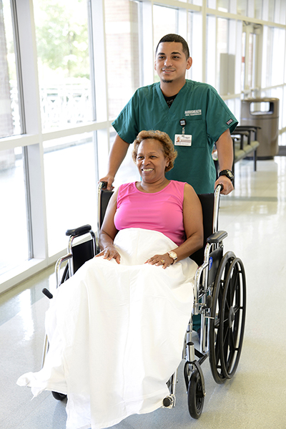

Thank you!!

